Slide 1
Level Design &
Environmental Storytelling

Slide 2
Today, You Will…
01
Block out a playable level
Using primitives, ProBuilder, or terrain tools — rough shapes first, polish later.
02
Tell a story without a single word
Lighting, object placement, and scale will do the talking.
03
Design a rhythm for your level
Apply tension and release so the space has a pulse, not a flat hum.

Slide 3
WARM-UP
Read the Room
You'll see four screenshots — no captions. For each one, you have 60 seconds to answer, in writing:
1
Who lived or worked here?
2
What happened right before this moment?
3
What are they supposed to do next?
NO TEXT. NO DIALOGUE.
JUST THE ROOM.
Keep your answers — you'll compare them to the real story later.

Slide 4

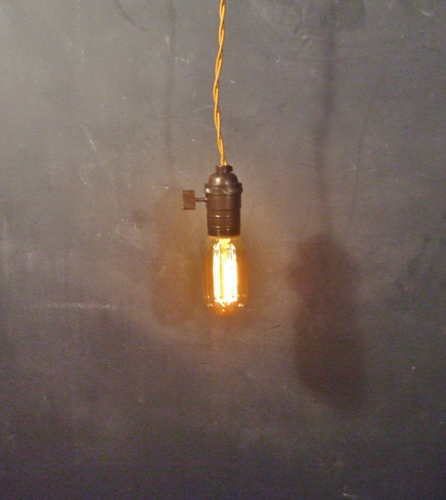
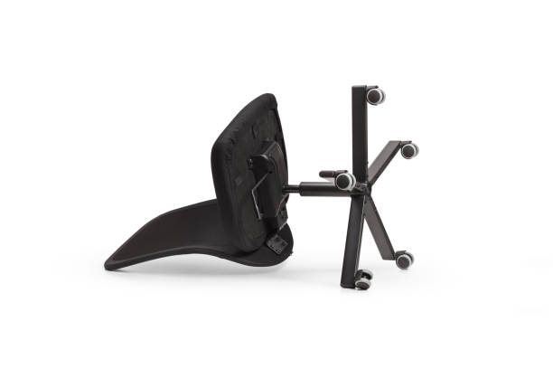
The Big Idea: Environmental Storytelling
Telling a story through the placement of objects, lighting, and space — instead of dialogue or text.
Games don't get a narrator. A room has to do the talking. Three classic moves:
The Locked Door
The One Working Light
The Overturned Chair
Scratch marks around the handle. Someone tried to get out — or in — and didn't.
A row of broken bulbs and a single working one tells you exactly where to look.
Nobody arranges furniture that way on purpose. Something happened here, fast.

Slide 5
Words You'll Use Today
Blockout / Greybox
NavMesh
Light Falloff
A rough, untextured version of a level made from simple shapes — built to test layout, not to look pretty.
The invisible “walkable surface” Unity calculates from your geometry. If it has gaps, characters get stuck or fall through.
Light gets weaker the farther it travels from its source — a physical fact you can use to shape mood.
Line-of-Sight
Pacing
Prop
What a player standing in one spot, facing one direction, can actually see. Walls and angles control it.
The designed rhythm of a level — tight and tense, then open and calm, on purpose.
Any placed object (crate, chair, lamp) doing double duty as both scenery and story evidence.

Slide 6
Your Blockout Tool Belt
Pick the tool that matches the shape you need — all three can live in the same scene.
Primitives
ProBuilder
Terrain Tools
Cubes, planes, spheres scaled by hand.
Custom, editable room shapes.
Sculpted ground meshes.
Fastest. Great for a first-pass wall, floor, or platform.
Best for doorways, angled walls, and non-rectangular rooms.
Best for outdoor scenes or uneven, natural-feeling ground.

Slide 7

The Physics of a Lamp
Light intensity drops off with distance from its source — a real physical phenomenon you control with three sliders.
dim, far away
Range
How far the falloff reaches before light disappears entirely.
Intensity
How bright the center of the light is.
Color
bright, close
Warm = safety, comfort. Cool = danger, the unknown.

Slide 8
Line-of-Sight Is a Design Tool
What the player can see — from exactly where they're standing — is decided by your geometry, not luck.
hidden until you
round the corner
wall
player
Blocked sightlines create suspense. Opened sightlines create relief or a reveal — you choose which, room by room.

Slide 9

Design a Rhythm: Tension & Release
A good level isn't flat. It rises, spikes, and drops — on purpose.
Your job: decide which of your two rooms is the tension room, and which is the release — then build both differently on purpose.
TENSION
Room A entrance
Corridor narrows
The reveal
Room B opens up
Calm start
Tension climbs
Peak tension
Release

Slide 10
COMPUTATIONAL THINKING
Design Is a Constrained Problem
Every layout choice has to satisfy a story goal AND a technical rule, at the same time.
Constraints your build must satisfy today:
NavMesh has no gaps
Colliders cover every surface
Narrative
Goals
Great
Level
Technical
Constraints
Frame rate stays smooth
Sightlines work as intended

Slide 11
Your Mission: Two Rooms, One Story
Paper first: sketch before you build. A pencil is faster than the Editor for changing your mind.
ROOM A
ROOM B
Before you open Unity, answer:
“If someone saw Room A for 5 seconds with no text, what ONE prop or light would tell them what happened here?”
doorway
Write that answer down. It's your build target for the next 35 minutes.
Setting: where are we?
Conflict: what went wrong?
Goal: what should the player do?
Which room is tension — which is release?

Slide 12
Build Studio: Your 5-Step Workflow
Work through these in order — each step depends on the one before it.
1
Block out your two rooms to match your paper sketch's proportions — narrow reads as tight, open reads as calm.
2
Place lights: one directional light for overall mood, plus point lights for local pools of light and dark.
3
Drag in 3–6 props from the shared pack. Position each one as evidence, not decoration.
4
Bake the NavMesh (Window > AI > Navigation) and walk your level in Play mode — does the path actually work?
5
Check colliders on every walkable surface and obstacle. No invisible walls, no falling through the floor.

Slide 13
A Lighting Recipe to Start From
Not a rule — a starting point. Adjust once you see it in Play mode.
Room A — Tension
Room B — Release
Point light
Lighting
Dim, short Range
Directional light + a warm point light
Color
Color
Cool tone (blue/teal)
Warm tone (amber/gold)
Result
Result
Mostly dark, a few visible pools of light
Open, evenly lit, easy to read at a glance

Slide 14
Pro Tips — and Traps to Dodge
Props are evidence, not decoration
Walk it before you trust it
Before you place something, ask: “what does this prove happened here?” not “does this look cool?”
A level can look finished in the Scene view and still have NavMesh gaps at doorways. Always test in Play mode.
Darkness is a tool, not a mistake
Scale-check your doorways
You don't have to light every corner. Unlit space builds tension on purpose.
Could your character actually fit through it? A table taller than your character breaks the illusion instantly.

Slide 15
Peer Playtest: Trade Seats
Two rules make this work: the designer stays silent, and the playtester writes before they talk.
IF YOU'RE PLAYTESTING
YOUR OBSERVATION SLIP
• Walk the level in Play mode — no explanation from the designer first.
What happened here?
• Fill out your slip as you go, before discussing anything out loud.
Who lived or worked here?
• Answer honestly: what did the room actually tell you?
What do you think you're supposed to do?
If you're the designer: watch quietly, and hold your questions until after the slip is filled out.

Slide 16
Debrief & Exit Ticket
Compare your playtester's slip to your original storyboard, then write 3–5 sentences:
“What part of your intended story came through? What part didn't — and what specific light, prop, or layout choice do you think caused the gap?”

